Slide 1





Team 3
OATH Conflict Resolution Program
Data-Driven Insights, ROI, and Strategic Recommendations

Slide 2





01
OATH Persona

Slide 3
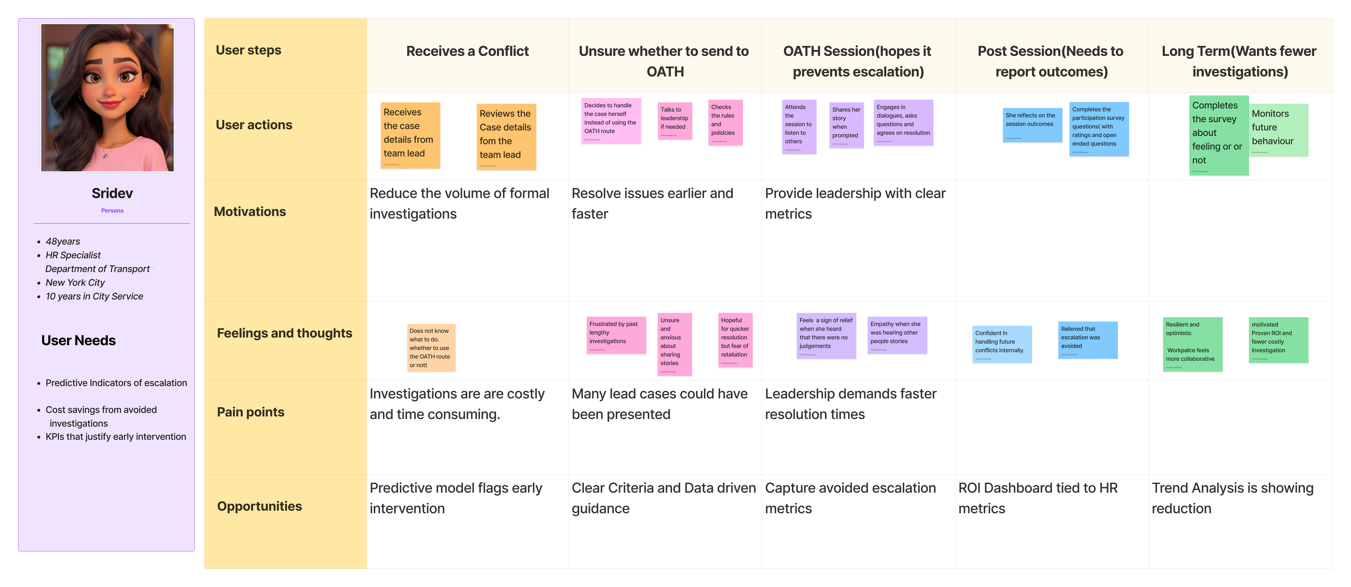


Slide 4


02
Dashboard & Metrics

Slide 5
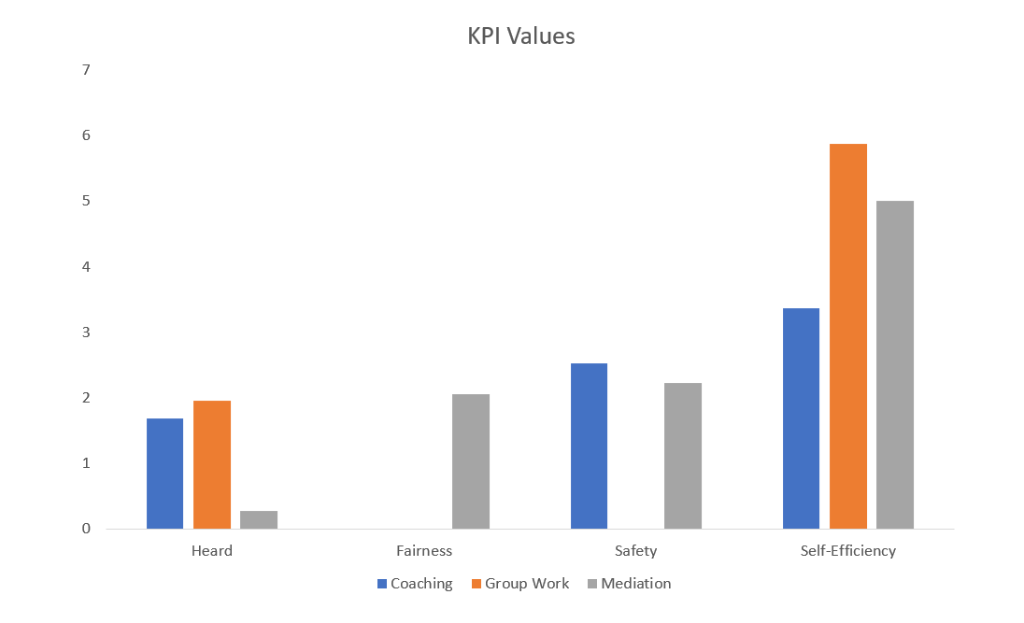
EXAMPLES:
Coaching: “I felt heard and understood.”
Group Work: “I was invited to speak openly and felt heard.”
Mediation: closest proxy available = “Mediator(s) listened attentively
“Low”
=
Disagree
+
Strongly disagree

Slide 6
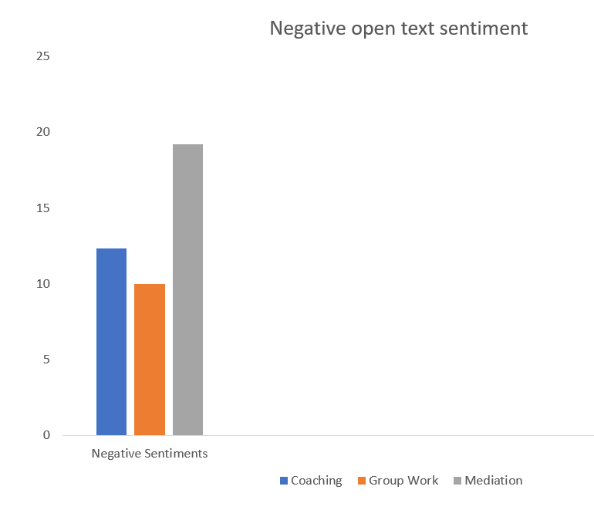
EXAMPLES:
felt ignored
dismissed
talked over
no one listened
Negative open-text sentiment = % of comments classified negative via keyword scoring

Slide 7
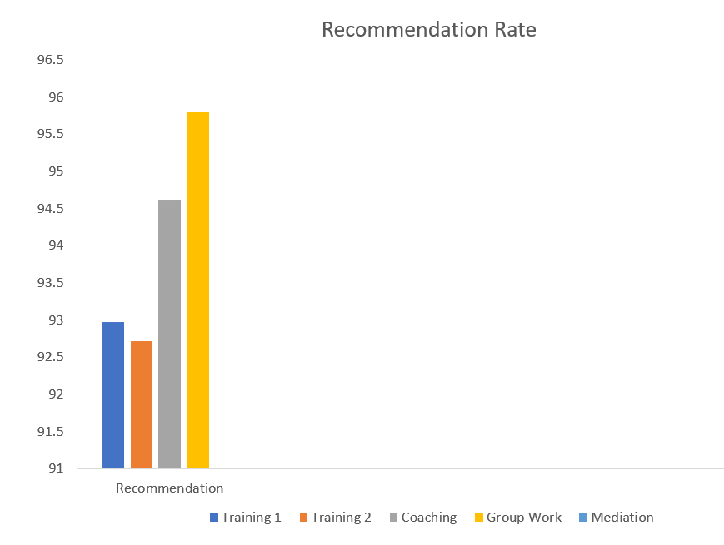
EXAMPLES:
highly recommend
would absolutely recommend
strongly recommend
cannot recommend enough
life-changing
transformative
invaluable
Recommend = Agree + Strongly Agree

Slide 8



03
Data Insights

Slide 9



Mediation
Coaching
Group Work
91% satisfaction with the mediation process, showing the program’s effectiveness in resolving interpersonal conflicts. This is a strong indicator of cost savings in avoiding HR/legal
85% of participants reported feeling more equipped to handle conflict, demonstrating improved conflict resolution skills and reducing future HR involvement.
81.4% improvement in team collaboration and morale, indicating positive workplace culture and enhanced teamwork post-intervention.

Slide 10




04
The Cost-Benefit Analysis

Slide 11
Avoided HR/Legal Costs:
Avoided Turnover Costs:
Avoided Absenteeism Costs:
100 cases × 10,000 average cost
= 1,000,000 in savings
1% reduction × 50,000 cost per employee
= 50,000 saved annually
100 employees × 1,000 × 10%
= 10,000 saved annually

Slide 12



85.1%
Conflict Resolution Effectiveness
90.3%
Satisfaction & Engagement
81.4%
Team Collaboration & Morale

Slide 13



"For every $1 invested in OATH, $88.33 is saved in avoided HR/legal costs, turnover, and absenteeism."
Return on Investment

Slide 14



$1,060,000
HR/legal costs, turnover savings, and absenteeism costs

Slide 15
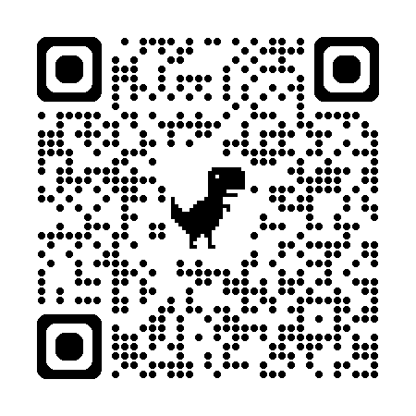
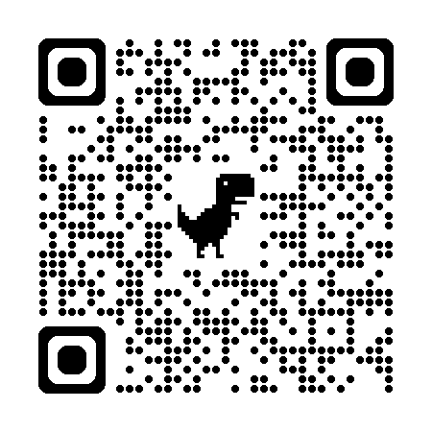

Thanks!
GROUP WORK/RESTORATIVE PRACTICES PARTICIPANT SURVEY
PARTICIPANT SURVEY

